Slide 1
PSFD PRESENTATION
TEAM:-
S.J SUMANTH(2010030377)​
K.SREEVARUN(200030451)​
E. PAVAN SAI(2010030538)​
E. SHIVA GOUD(2010030542)​

Slide 2
Handwritten Digit Recognition using Python
REFERENCE: Deep Learning Project - Handwritten Digit Recognition using Python - DataFlair (data-flair.training)

Slide 3
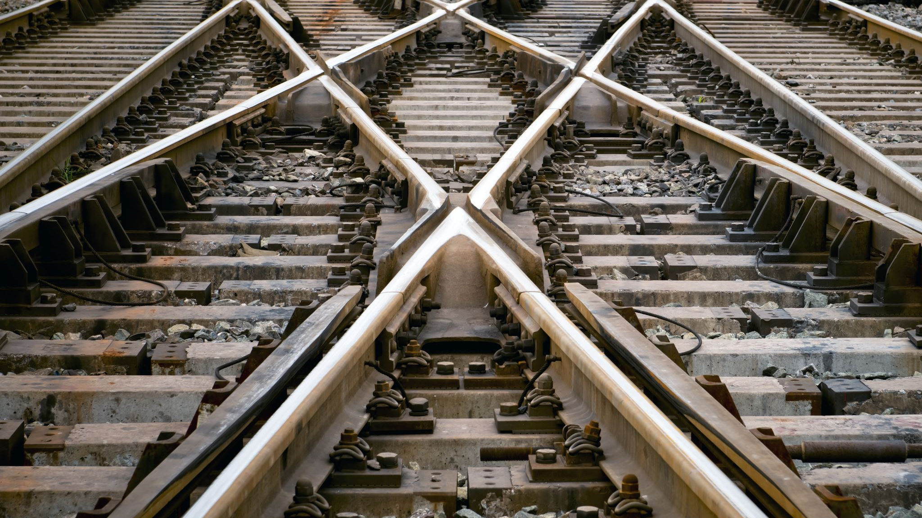
Outline
Abstract
Introduction
Flow Chart
Implementation
GitHub Commits
Conclusion

Slide 4
Abstract
Optical Character Recognition (OCR) is a subfield of Image Processing which is concerned with extracting text from images or scanned documents.
An OCR system depends mainly on feature extraction, recognition and classification into appropriate labels.
In this project, we have chosen to focus on recognizing handwritten digits with at most accuracy.
The challenge in this project is to use CNN algorithm, in order to maximize the accuracy of predicting the handwritten digits.

Slide 5
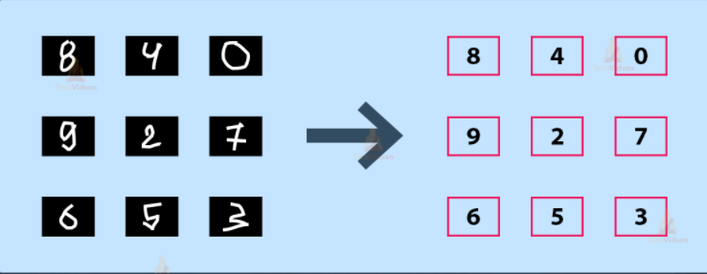
Introduction
It is easy for the human brain to process images and analyze them. When the eye sees a certain image, the brain can easily segment it and recognize its different elements. The brain automatically goes through that process, which involves not only the analysis of this images, but also the comparison of their different characteristics with what it already knows in order to be able to recognize these elements. There is a field in computer science that tries to do the same thing for machines, which is Image Processing.
Image processing is the field that concerns analyzing images to extract some useful information from them. This method takes images and converts them into a digital form readable by computers, it applies certain algorithms on them, and results in a better-quality images or with some of their characteristics that could be used in order to extract some important information from them.

Slide 6
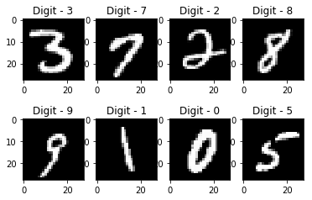
Introduction
One of the narrow fields of image processing is recognizing characters from an image, which is referred to as Optical Character Recognition (OCR). This method is about reading an image containing one or more characters or reading a scanned text of typed or handwritten characters and be able to recognize them. A lot of research has been done in this field in order to find optimal techniques with a high accuracy and correctness. The most used algorithms that proved a very high performance are machine learning algorithms like Neural Networks and Support Vector Machine.
The goal of this project is to apply and manipulate the basic image correlation techniques to build program and keep polishing and enhancing in order to investigate to which extent it can get improved.

Slide 7

Start
Import the libraries
load the dataset using “keras.datasets import minst”
FLOW CHART
Create the CNN model
Train the model using minst dataset
Divide the dataset into test.csv and train.csv

Slide 8
Test the model using minst dataset
Now create a GUI Interface for user input (eg: canvas)
Draw the number on the created canvas and press recognize
Displays the digit with accuracy percentage
Stop

Slide 9
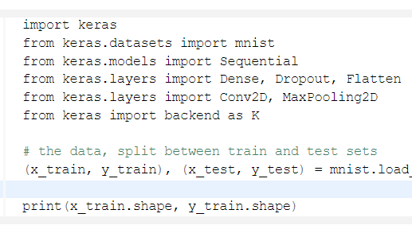
Import the libraries and load the dataset

Slide 10
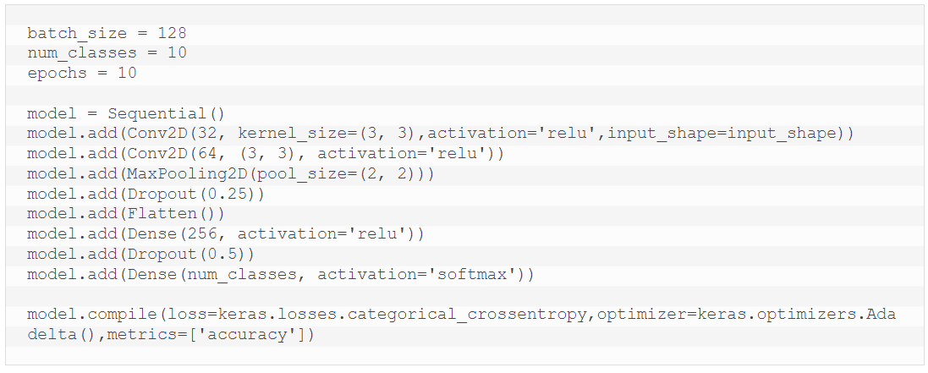
Create CNN Model
A CNN model generally consists of convolutional and pooling layers. It works better for data that are represented as grid structures, this is the reason why CNN works well for image classification problems. The dropout layer is used to deactivate some of the neurons and while training, it reduces offer fitting of the model.

Slide 11
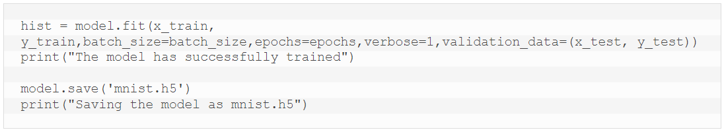
TRAIN THE CNN Model
The model.fit() function of Keras will start the training of the model. It takes the training data, validation data, epochs, and batch size.
It takes some time to train the model. After training, we save the weights and model definition in the ‘mnist.h5’ file.

Slide 12
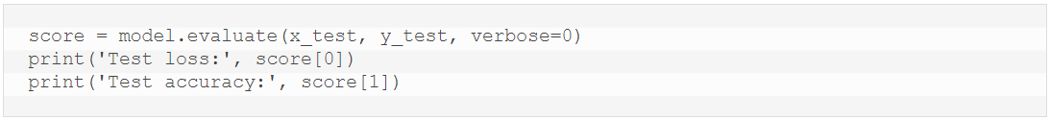
EVALUATE THE CNN Model
We have 10,000 images in our dataset which will be used to evaluate how good our model works. The testing data was not involved in the training of the data therefore, it is new data for our model. The MNIST dataset is well balanced so we can get around 99% accuracy.

Slide 13
Implementation

Slide 14
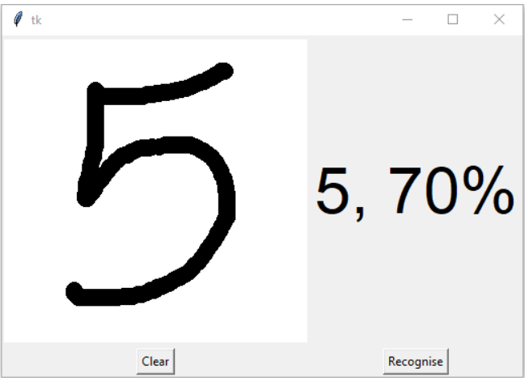
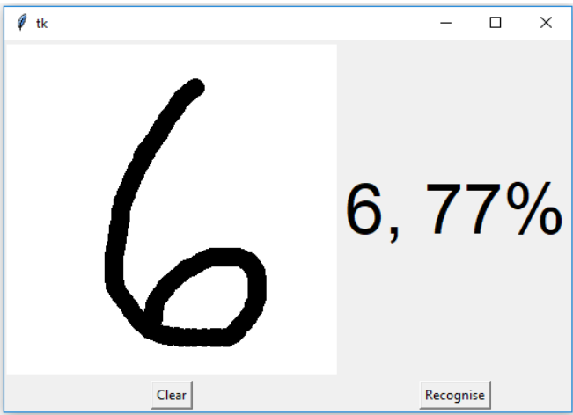

Slide 15
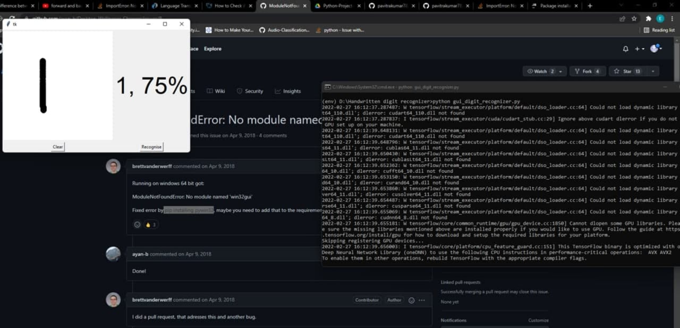
Work Progress :

Slide 16

GITHUB commits:

Slide 17
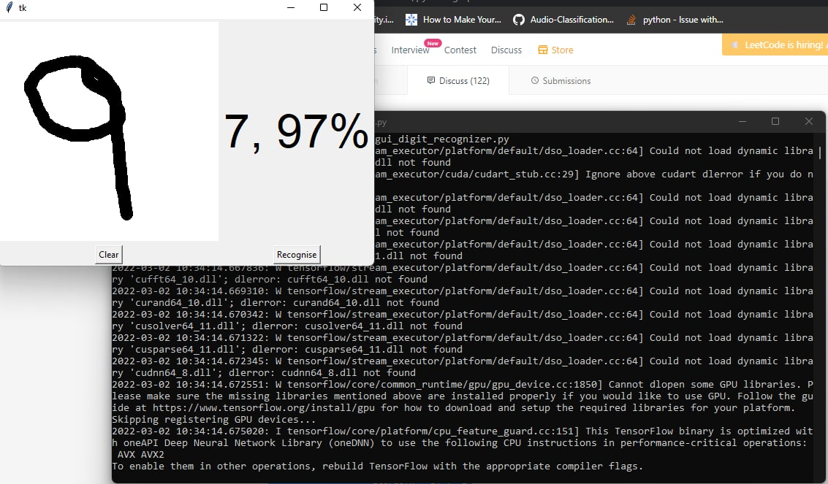
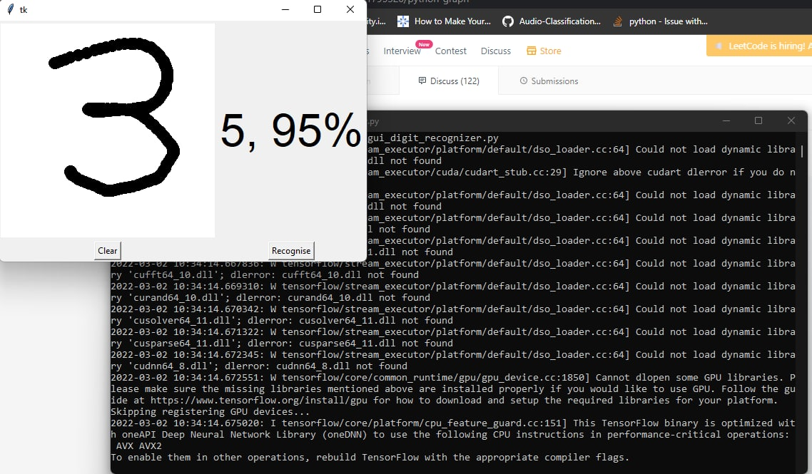
Alpha Testing:

Slide 18

Conclusion:
Several OCR systems were studied and accurate methods, techniques were analyzed. OCR is a challenging area of research and introduces new challenges with its changing dynamics.
The most widely used Machine learning algorithm i.e CNN will be trained and tested on the same dataset in order acquire the comparison between the classifiers. Utilizing these deep learning techniques, a high amount of accuracy can be obtained

Slide 19


